Slide 1
Pump it Up: Data Mining the Water Table
big and little data in healthcare | uchicago

Slide 2
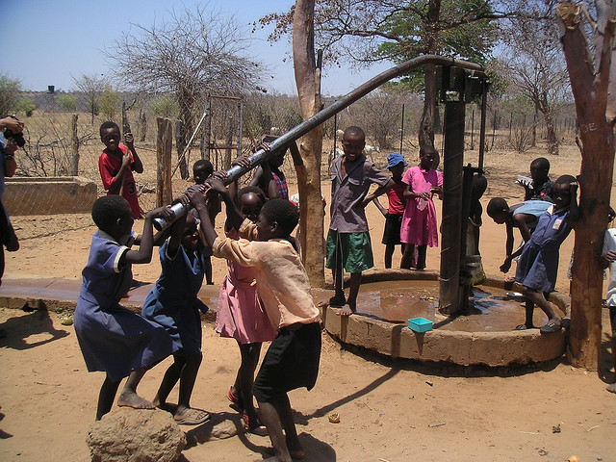
Introduction
Many of Tanzania’s residents go to great lengths to get clean water
Having a stable and reliable source of water greatly improves their well-being
Government initiatives and other entities have installed water pumps across the land to provide one of life’s basic necessities
Trouble occurs when pumps degrade over time

Slide 3


Introduction
Special thanks to Taarifa and the Tanzanian Ministry of Water, which have supplied data on water pumps scattered across Tanzania
The data and competition is hosted on drivendata.org

Slide 4
Goal
Given 59,400 samples and 39 attributes, create a method that is able to predict three classes of water pumps:
Functional
Non-functional
Functional, but needs repair
We will use a machine learning approach (random forest classifier)

Slide 5

A Machine Learning Approach
Exploratory data analysis
Data preparation & feature selection
Build the algorithm
Evaluate the algorithm

Slide 6
Part 1: Exploratory Data Analysis

Slide 7
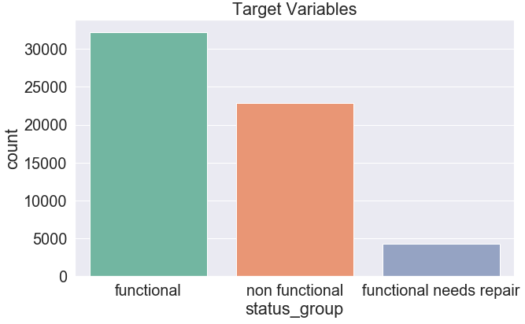
Labels to Predict

Slide 8

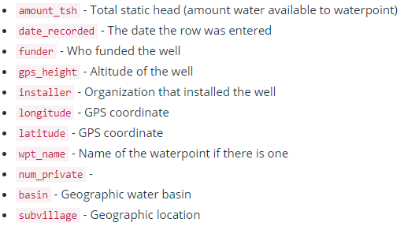

Data Features
11 out of 39 features are shown

Slide 9

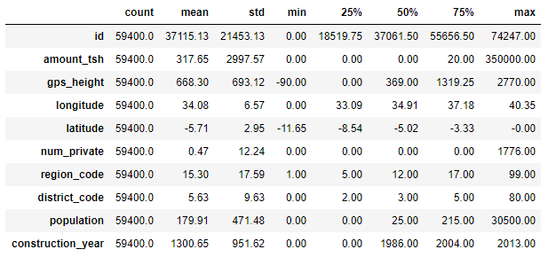
Descriptive Statistics in Python

Slide 10
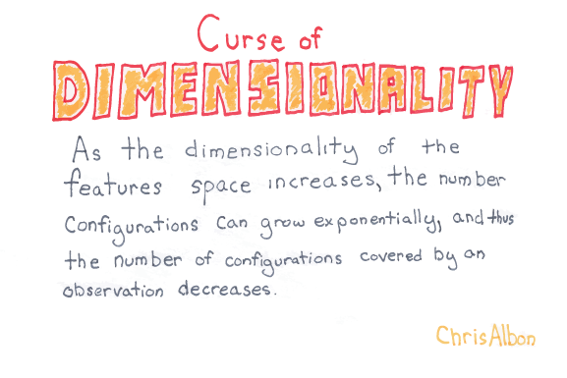
Part 2: Data Preparation & Feature Selection
Goal: remove unnecessary features from the dataset
Avoid overfitting and, the “curse of dimensionality”
Reformat and re-engineer variables

Slide 11
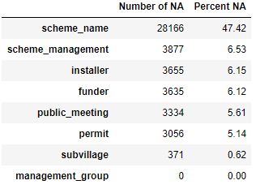
What to do with missing values?
Many ML algorithms can’t process null values and will need to be processed
3 ways:
Remove records with null values
Impute null values using mean, median, etc.
Convert null values into useful information

Slide 12


What to do with missing values?
Remove scheme_name, funder, installer, and subvillage:
Impute missing values:

Slide 13
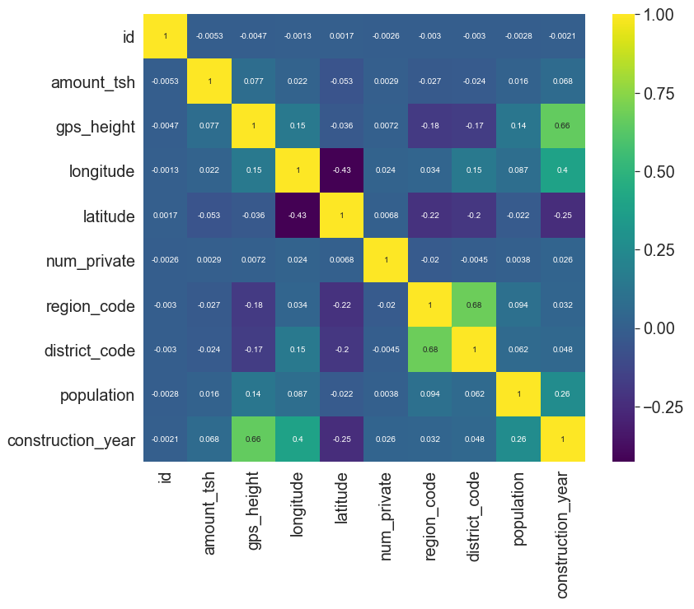
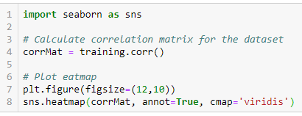
Correlation Matrix

Slide 14
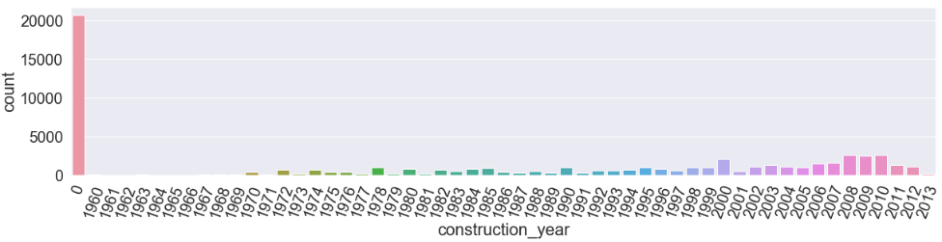
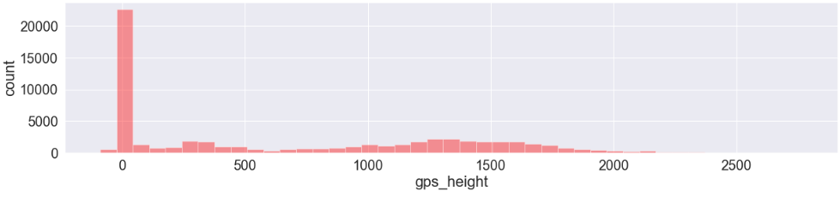
Construction Year & GPS Height

Slide 15
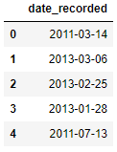
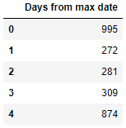
How can we use date_recorded?
Date variables can be converted to something more useful for the classifier to learn on
I calculate the number of days from the “max date” in the date_recorded column

Slide 16

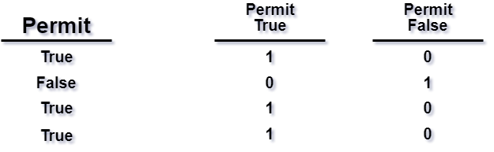
Convert Categorical Variables
Categorical variables will need to be converted with a method such as one-hot-encoding:

Slide 17
Part 4: Machine Learning

Slide 18
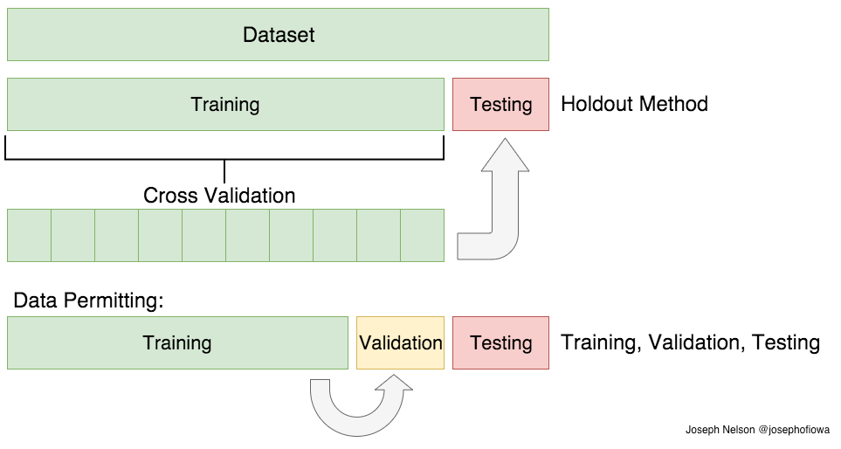
Supervised Machine Learning

Slide 19
Random Forest Classifier
A supervised machine learning algorithm that creates many decision trees.
A decision tree is a weak-learner, but having many of them together can really boost the accuracy
Also called an ensemble

Slide 20
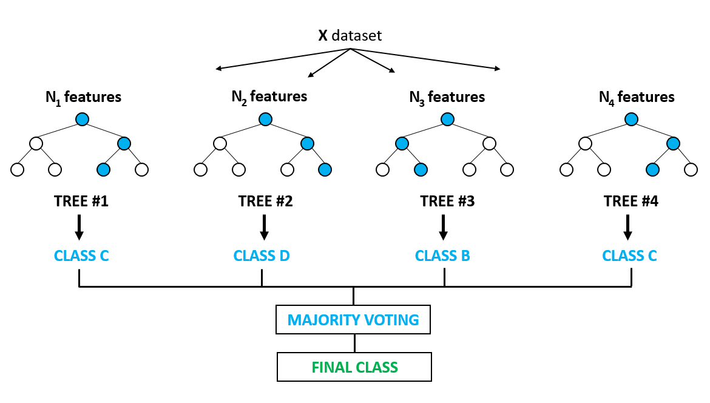
Random Forest Classifier

Slide 21
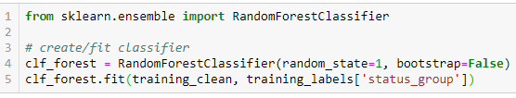
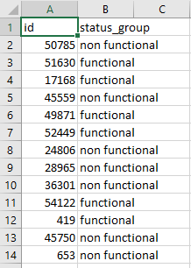

Random Forest Classifier
Running the classifier:
Predict labels for the testing set and store in a .CSV file:

Slide 22
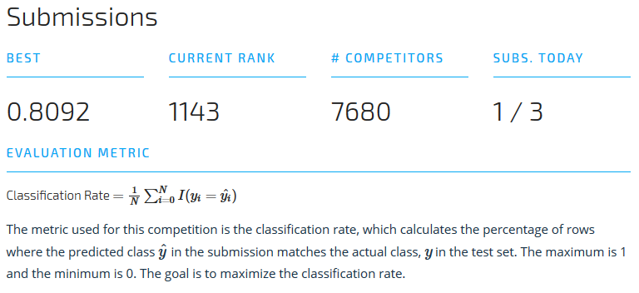
Part 4: Algorithm Evaluation

